Slide 1


N95 Decontamination Service
NDS
April 2020

Slide 2
COVID 19 Immediate Objective:
The objective of performing this supply and decontamination service is to guarantee the health and safety of all frontline staff who need a sterilized N95 mask at the start of each shift as a stopgap until the mask supply chain is restored.
This will involve well orchestrated logistics to first and foremost make sure that each mask is ready for reuse within a very short period of time. The uninterrupted supply of masks is imperative with decontamination.
As the masks are processed, there will be a thorough analysis to inspect each mask to make sure it can be reused concurrently. Bad elastics, gaps and fluid stains will cause the removal of these items from circulation.

Slide 3
The Decontamination Process:
TSG will schedule pick-up of contaminated masks from your facility. Masks should be sealed in bags or containers to prevent COVID 19 transmission issues while in transit.
TSG will hand deliver the masks to our facility for decontamination.
The facility will begin the process by first inspecting for issues that would prevent decontamination. Damaged/soiled masks are then placed into a container for disposal. These masks are then removed from circulation and a list will be given back to the facility to account for the number of defective masks not being returned.

Slide 4
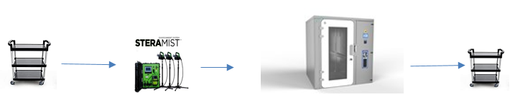
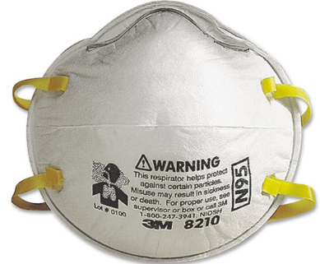
The Decontamination Process Continued:
Once through the inspection, qualified masks are staged inside our chamber where the 7.8% hydrogen peroxide mist/fog will fully sterilize the mask. Once completed, there will be a short period of aeration.
Decontaminated masks will be validated and then placed into a sterile bag. Sortation by location and packaging will then be performed.
Contaminated Mask
Decontaminated Mask

Slide 5
SteraMist™ is EPA List N Approved to fight COVID 19. This technology also has FDA and USDA approvals for use.
SteraMist™ Provides:
Six-Log Kill (99.9999%) on Clostridium difficile spores.
Kills pathogenic bacteria and Deodorizes by killing odor causing bacteria.
Less down time than competing technologies.
Precise measurement of H₂O₂ disbursement.
Fully validated to comply with GMP (Good Manufacturing Practice) Standards.
iHP fog kills and inactivates bacteria and viruses in even the most hard-to-reach areas.

Slide 6
Cost Effectiveness:
Although the perfect solution is to replace masks after every shift, due to the COVID 19 outbreak, this is no longer always possible.
This solution is meant as a stopgap measure to ensure all healthcare workers and first responders have enough medical supplies to keep them as safe as possible during their shifts. We also have the capability to decontaminate other items while in the chamber if so desired.
Although we have set pricing for the decontamination system based on rollout and volume, the cost of an N95 mask varies from day to day as well as availability. We do have CDC approved N95 NIOSH masks available for sale. Pricing will be based upon current supply and number of masks sought to purchase.

Slide 7
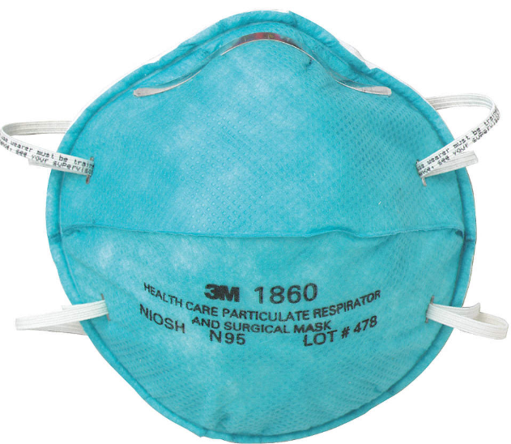

Proposed Future Solution (New Masks): Pick up station -
Hospital personnel will be issued new N95 masks with a unique barcoded serial numbers on it assuming it is processed through the system.. TSG will provide a standalone barcode printer with a touch screen menu driven application to generate this label. It will be placed on the exterior of the mask. The user would then create a record in a secure Web Based system using the touch screen. We would recommend the following data to be collected:
Name
Employee ID (scanned)
Hospital Name (touch screen)
Location (Building/Floor) (Touch screen)
Email Address (optional)
Phone Number (optional)
Mask ID numbers assigned
Masks will then be staged by the facility and delivered to authorized hospital project lead for distribution.

Slide 8

Future Recommended Process (Decontaminated Masks):
Pick up/Drop off –
Hospital personnel will receive back the decontaminated/sterilized masks in an agreed upon secure bag with identification information to ensure these masks are their property.
As the masks are distributed from a designated area , the user will access the web-based system to scan their bag containing the sterilized mask.
This process will log that the user picked up their mask.
This area will also act as a drop off point for used masks which will be discarded in a hazmat bin for future decontamination.
NOTE: If the user is picking up a mask on the final cycle (5th), the system will warn the user to discard the mask after it’s use. If the mask enters the decontamination process again, it will be flagged and disposed of.

Slide 9
Future Web Based Cloud Approach:
TSG would design a web application which includes a database to be able to effectively provide the following benefits:
Ease of access to ALL who are authorized to use the system.
Ensure that only 5 uses are in force of each eligible mask.
Complete visibility to all employees and staff to have total knowledge of what inventory is in place.
Provide real-time data 24/7/365 as to the status of masks.
Include an extra quality control to ensure defective masks are not reused.

Slide 10
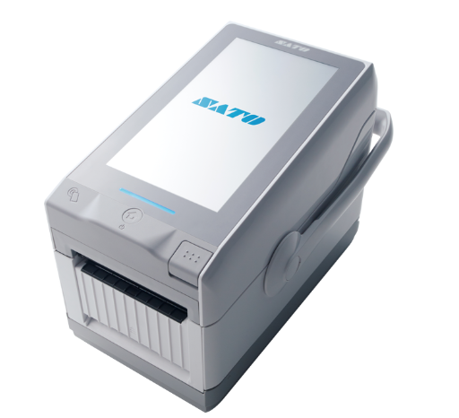
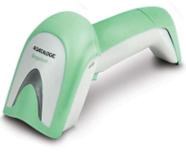
The SATO America FX3 printer will record the employee data and print the barcode. This will include a direct connection to the web-based cloud system for processing and archiving. Antimicrobial scanners are used for mask returns and updates for non-contact processing.

Slide 11
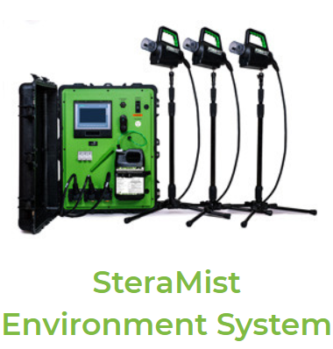

Conclusion:
Using a completely automated system to track masks from pickup to delivery will achieve the best ROI possible while giving your staff the visibility they need to feel safe there will be masks available. This, in conjunction with SteraMist, will guarantee complete sterility of the PPE devices. You can also be assured of a completely cost- effective alternative to using new masks at a fraction of the cost.
Although this system’s deployment may not be optimal at this time, you can begin to plan for future events that can take advantage of this approach.

Slide 12

Contact Information
Tom Jackson; Chairman/COO/President
Tom.jackson@t-sgrp.com
Office: 443-542-5546, ext. 103
Cell: 410-707-0799
Russell S. Gardner III; CEO/CMO
russell.gardner@t-sgrp.com
Office: 443-542-5546, ext. 100
Cell: 443-562-7989
Kevin Holmboe; Sr. Project Manager
Kevin.Holmboe@t-sgrp.com
Office: 443-542-5546, ext. 104
Cell: 410-271-0268

